Slide 1
Beyond Assessment Scores
How Behavior Can Give Insight into Knowledge Transfer
Christopher G. Brinton, PhD
Head of Advanced Research, Zoomi Inc.
Visiting Lecturer and Research Scholar, Princeton University
Notes:
----- Meeting Notes (8/18/15 16:31) -----
LMS cornerstone on demand. HR Workday now.

Slide 2
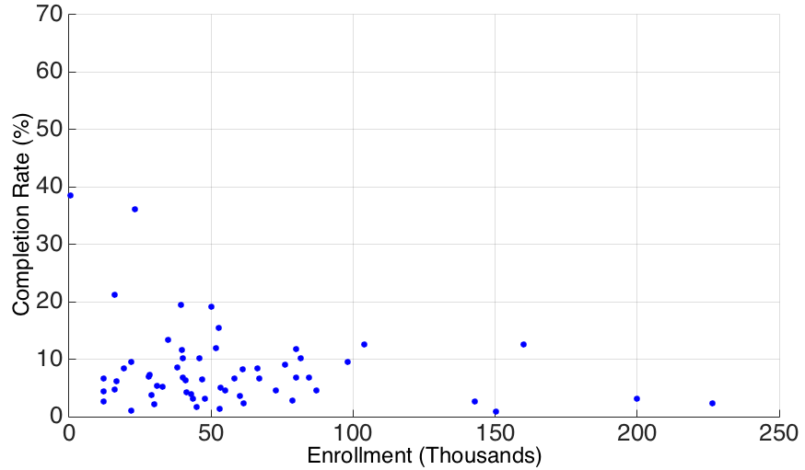


Big Data for Learning
Lift this curve!
Online learning today
Convenient, massively scalable
Lower engagement vs. in-class
Scale-efficacy tradeoff
What could improve it?
Fine-granular analytics
Automated individualization
Learning how students learn
How to do that?
Data presents massive opportunity
Measure, model, personalize
Student
Interaction
Measure
Behavior
User
Modeling
Personalize
Content

Slide 3
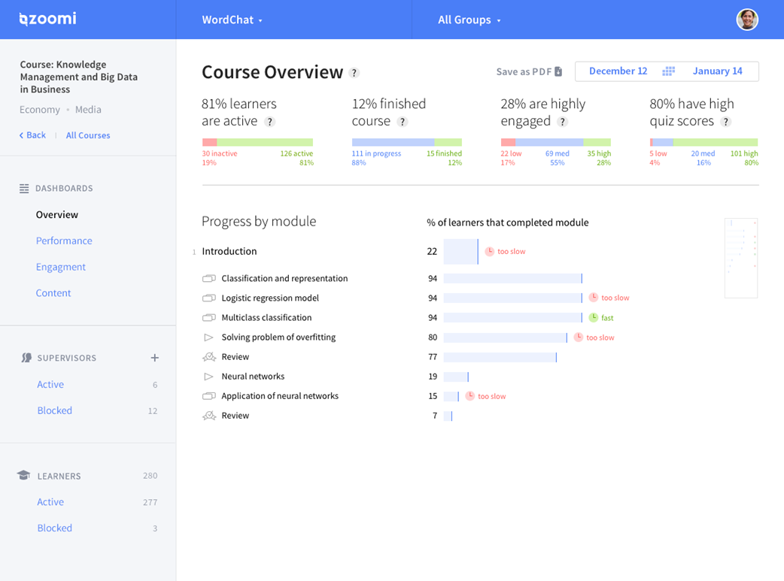
Overview of Zoomi
Platforms
Player: Course delivery
Dashboard: Learner and content analytics
Engine: “Deep” personalization
Servicing
Corporate training
Professional certification
Open Online Courses / MOOC
Private tutoring
Higher education

Slide 4

Processing Behavioral Data
Four types
Clickstream measurements
Social interactions
Assessment responses (sparse!)
Content words
Denoising data
Off-task behavior
Stopword filtering
Small-talk discussion
Model learning
First compute feature sets

Slide 5
Zoomi’s Artificial Intelligence Taxonomy
Network
Mining
Deep
Learning
Sequential
Pattern
Mining
Reinforcement
Learning
Everyone’s taxonomy is different!
Data
Mining
Predictive
Modeling
Natural
Language
Processing
Supervised
Learning
AI
Engine
Algorithms feed to …
Dashboard (analytics)
Player (personalization)
LMS / CMS / ESN / backend / ...
Dimensionality
Reduction
Feature
Selection
Latent
Factor
Extraction
Clustering

Slide 6
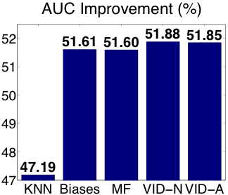
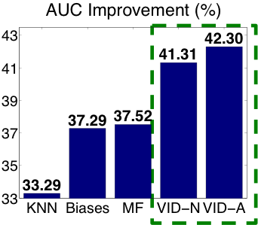
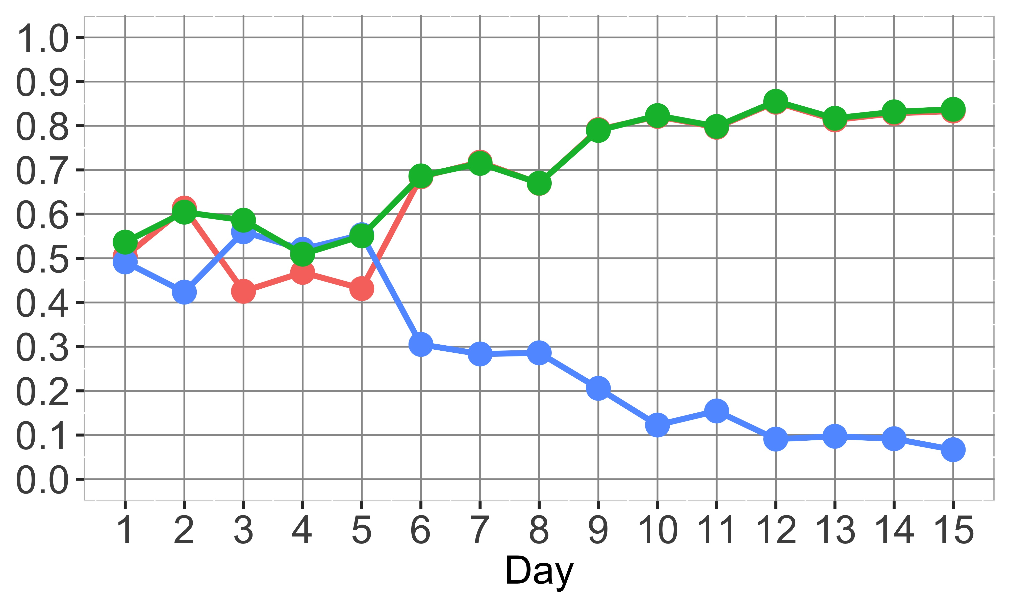
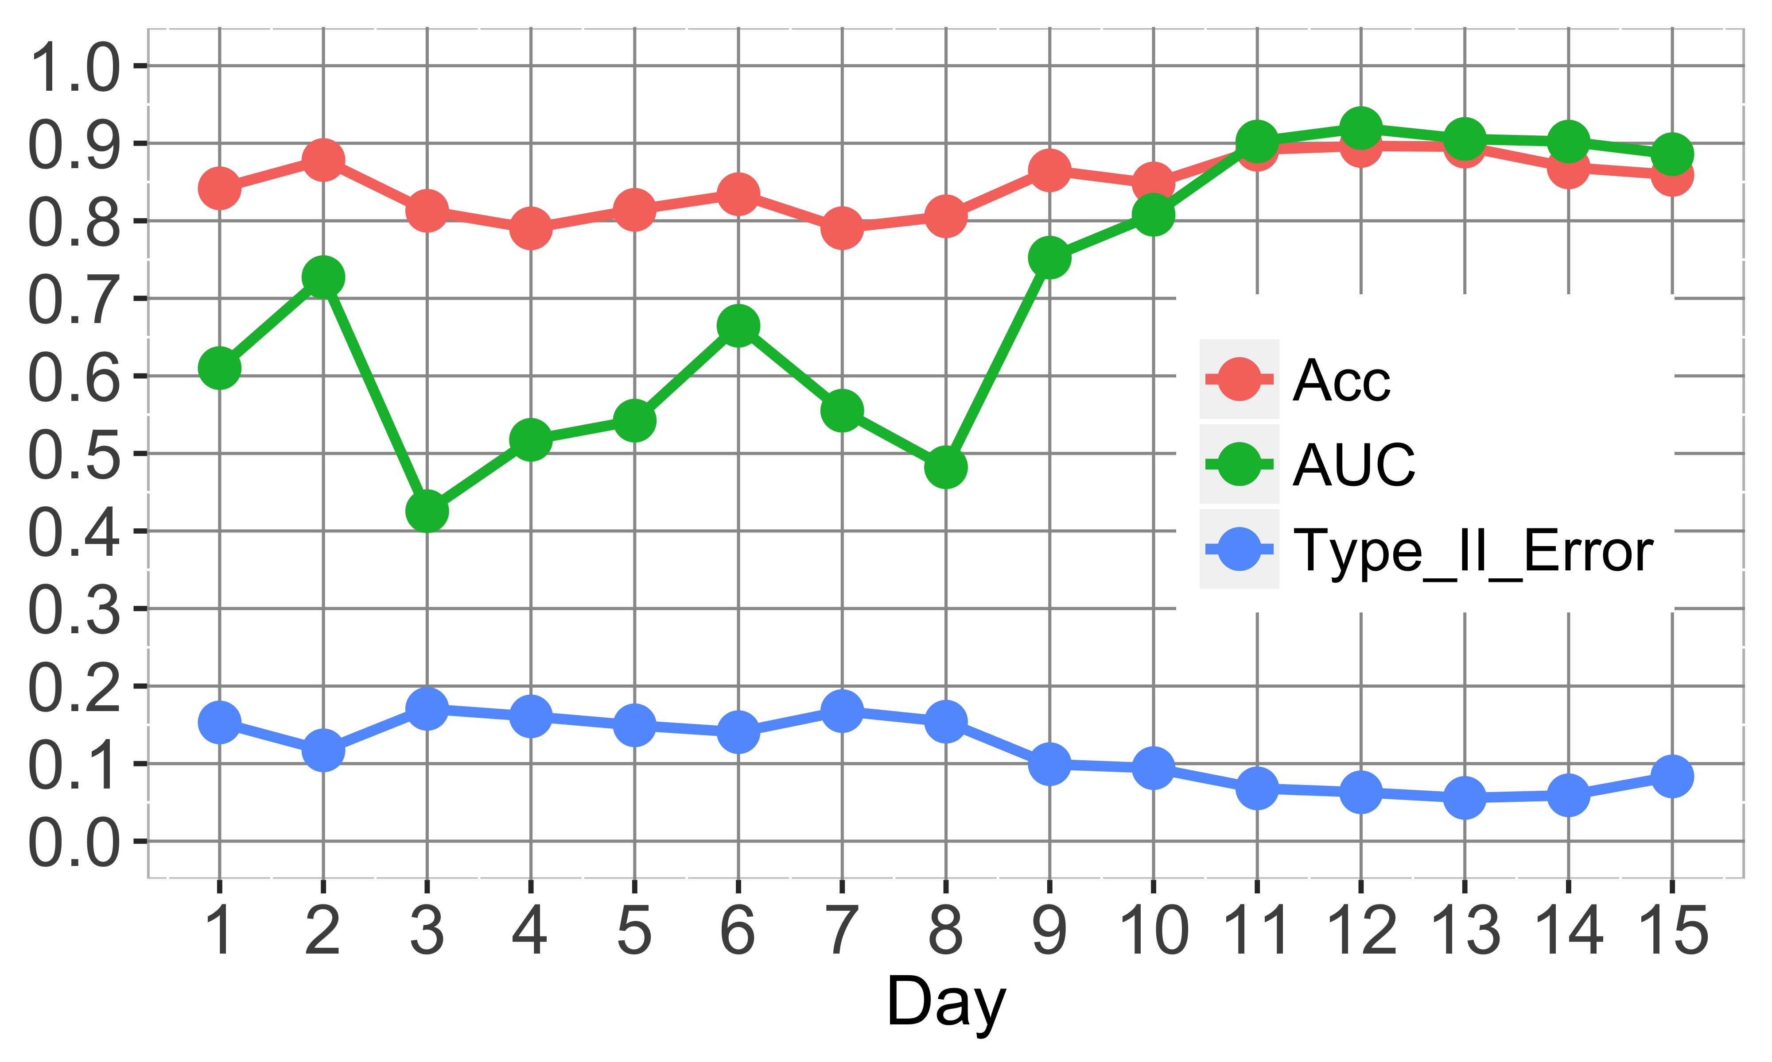
Behavior-Based Outcome Prediction
Representing clickstream behavior
Aggregate quantities: Completion rate, time spent, engagement, ...
Sequences of events, lengths/durations, and/or positions
Early detection of outcomes from behavior
E.g., 85% AUC in predicting P/F within first ten days
Massive Open Online Courses
Corporate Training
Full course
First two weeks
INFOCOM 2015
INFOCOM 2017

Slide 7
Motifs: Sequential Pattern Mining
Significantly recurring subsequences of behavior
Group | Interpretation | Sample |  | Δc(%) | p-value
Reflecting | Short to medium-long plays interspersed with short to long pauses | [Pl1 Pl3] Pa4 Pl2 Pa3 [Pl2 Pl1] | FMB | +4.89 | 0.013*
 |  | Pl1 Pa1 Pl1 Pa1 Pl1 Pa1 | NI | -5.29 | 0.036*
Reviewing | Playing for a length, and reviewing some or all of the content | Sb3 [Pl2 Pl1] [Sb2 Sb3] Pl2 Sb2 | FMB | +7.52 | 0.0068**
 |  | Sb2 [Pl2 Pl1] Sb2 Pl2 Sb2 | NI | +9.63 | 0.0078**
Skimming | Long skips forward with short to medium plays in-between | [Pl2 Pl1] [Sf2 Sf3] Pl1 [Sf3 Sf2] | FMB | -4.75 | 0.0096**
 |  | [Pl3 Pl1] [Sf3 Sf4] [Pl1 Pl2] [Sf4 Sf3] [Pl1 Pl2] | NI | +6.45 | 0.085.
Speeding | Viewing at faster than default, slowing down for important content | Rf Rd [Pl1 Pl2] Rf Pl3 | FMB | +9.30 | 0.039*
 |  | [Pl1 Rd] Rf Pl1 Rf Rd | NI | -10.8 | 0.016*
Transactions on Signal Processing 2016
Correlations dispel ambiguity around effective behaviors

Slide 8
Behavior for Content Analytics
1. Read more than 25 sec
3. Read 10 to 25 sec
22
23
24
29
30
31
32
Performing the sequential skimming actions of (i) spending more than 25 seconds on a slide, followed by (ii) skipping forward 5-15 slides, followed by (iii) spending 10-25 seconds on a slide five more times will lower performance on the exam by -33.9%.
2. Skip forward 5 to 15 slides
1. Read 1 to 10 sec
65
66
67
70
71
72
73
2. Skip forward 5 to 15 slides
Performing the sequential actions in the Mortgage Life Cycle module (slides 65-90) of (i) spending 1-10 seconds on a slide followed by (ii) skipping forward 5-15 slides five more times will improve the chance of success on Q17 by +3.0%.

Slide 9
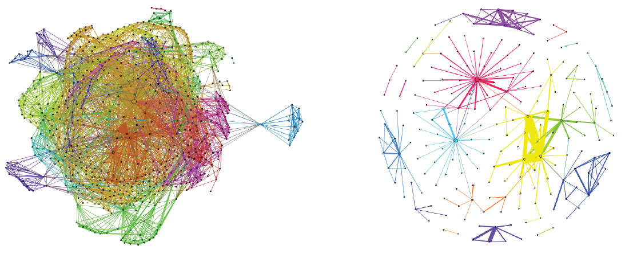
Social Learning Networks
Optimize interaction communities
Seeking and disseminating tendencies
Tradeoff local and global utilities
INFOCOM 2016

Slide 10
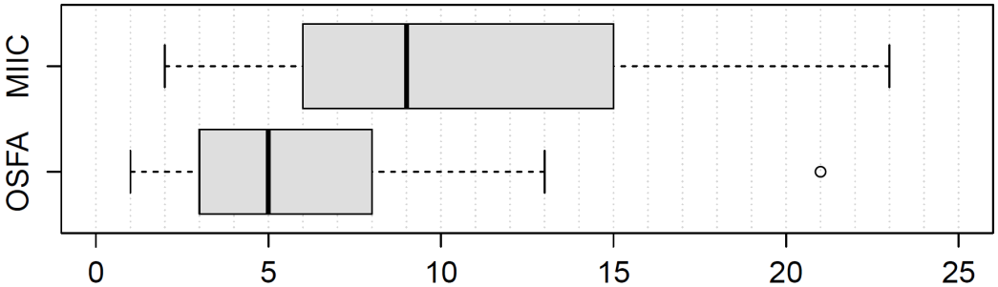
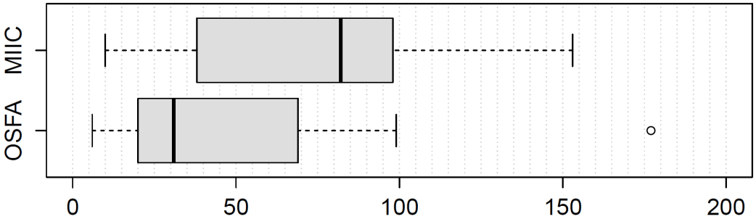
Behavior-Based Individualization
UM Spec
Curr UM
T2
New UM
T1
T1
Q
<T1 Rev, T1 Perf,
T2 Rev, T2 Perf>
<1, 2, 0, 3>
<2, 1, 1, 2>
Reviewing
Reviewing
Incorrect
Total Page Count
Total Object Count
Statistical Test | Wilcoxon | Welch
p-value | 0.009** | 0.009*
95% CI | (1, 7) | (0.93, 7.26)
HLE | 4 | 4.09
Statistical Test | Wilcoxon | Welch
p-value | 0.010** | 0.042*
95% CI | (7, 53) | (1.00, 49.78)
HLE | 27 | 25.39
Transactions on Learning Technologies 2015

Slide 11
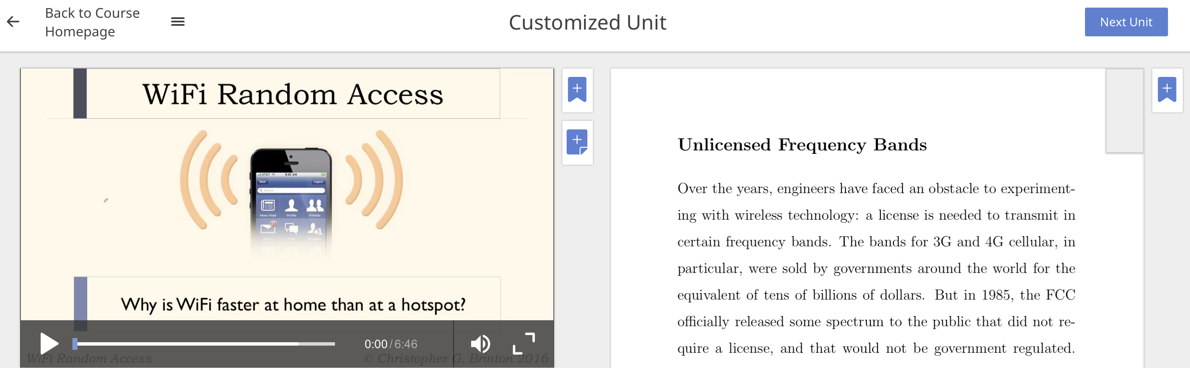
“No-Touch” Individualization
Eliminates up-front “burden” on instructors
No tagging content, no defining branching logic
Creating customized segments
Text mining finds relationships between content pieces
Performance on topics determines points of struggle
Engagement on segments detects learning mode preferences

Slide 12
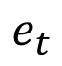
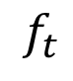
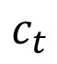
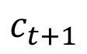
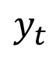
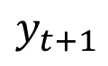
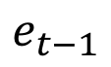
Click-Trace
$$y_{t}$$
$$y_{t+1}$$
Work in progress
SPARFA
Factors
Engagement (hidden)
Knowledge state (hidden)
Behavior (observed)
Performance (observed)
$$c_{t}$$
$$c_{t+1}$$
$$e_{t−1}$$
$$e_{t}$$
$$f_{t}$$

Slide 13
References
C. Brinton, M. Chiang. The Power of Networks: Six Principles that Connect our Lives. Princeton University Press, 2016.
C. Brinton, R. Rill, S. Ha, M. Chiang, R. Smith, W. Ju. Individualization for Education at Scale: MIIC Design and Preliminary Evaluation. IEEE Transactions on Learning Technologies, Vol. 8, No. 1, p. 136 – 148, 2015.
C. Brinton, M. Chiang. MOOC Performance Prediction via Clickstream Data and Social Learning Networks. IEEE INFOCOM, 2015.
C. Brinton, S. Buccapatnam, F. Wong, M. Chiang, H. V. Poor. Social Learning Networks: Efficiency Optimization in MOOC Forums. IEEE INFOCOM, 2016.
C. Brinton, S. Buccapatnam, M. Chiang, H. V. Poor. Mining MOOC Clickstreams: On the Behavior Between Learner Video-Watching Behavior and Performance. IEEE Transactions on Signal Processing, 2016.
W. Chen, C. Brinton, D. Cao, M. Chiang. Behavior in Social Learning Networks: Early Detection for Online Short-Courses. IEEE INFOCOM, 2017.

Slide 14
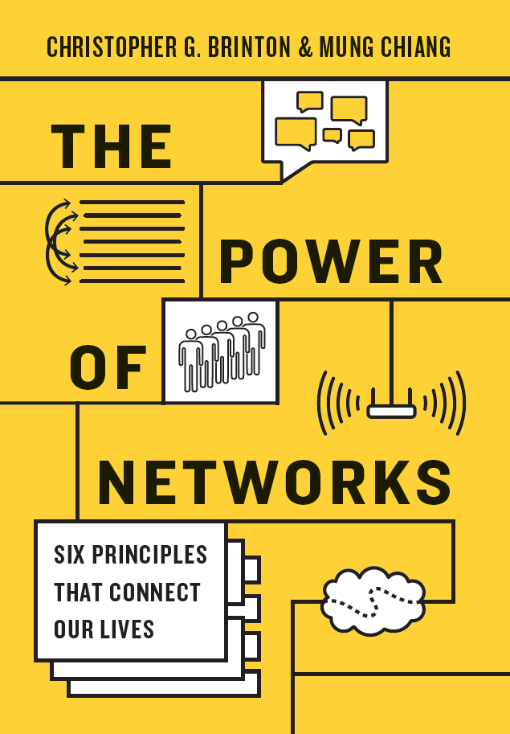
Thank You!
Christopher G. Brinton, PhD
Head of Advanced Research, Zoomi Inc.
Research Scholar and Lecturer, Princeton University
Adjunct Professor of Engineering, TCNJ
chris.brinton@zoomiinc.com
www.cbrinton.net
www.powerofnetworks.org
Special thanks to:
Swapna Buccapatnam, Da Cao, Weiyu Chen, Mung Chiang, Sangtae Ha, Carlee Joe-Wong, Andrew Lan, Zhenming Liu, William McColgan, Vince Poor, Rüdiger Rill, Joseph Urciuoli, Bree Varney, Jim Walker, Felix Wong, Jimmy Yang, Liang Zheng

